Slide 1
Introduction To Chemistry – Feb 9
Coloring The Periodic Table
First 20 Elements Worksheet
Upcoming:
Tomorrow - Atoms & Elements

Slide 2
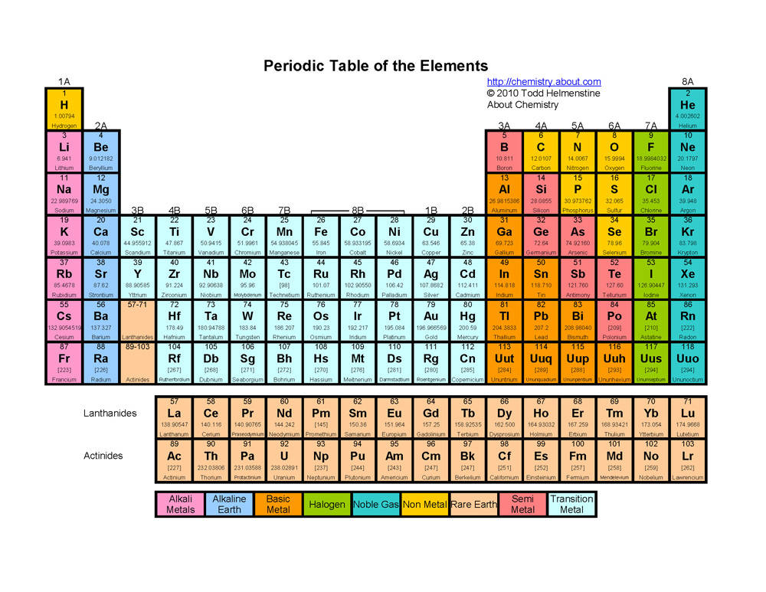
Periodic Table Groups & Colours

Slide 3
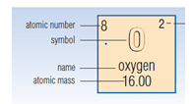
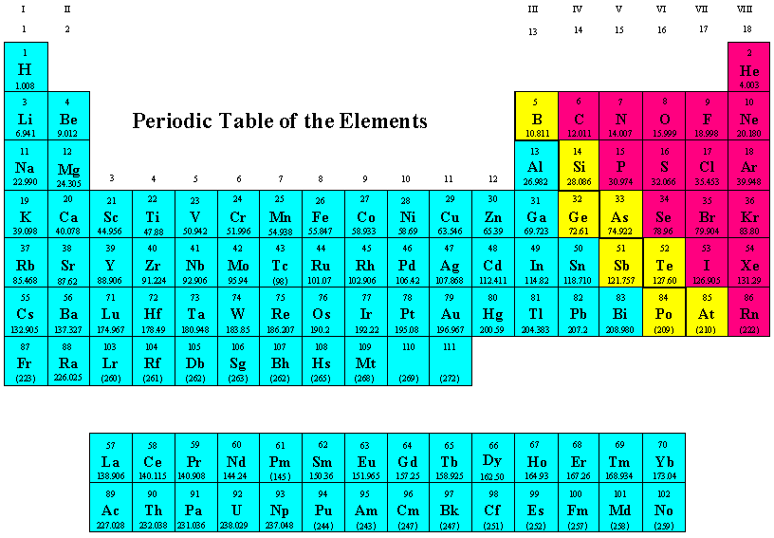
Periodic Table Names & Symbols
Non- Metals
Metals
Metalloids

